Slide 1
1150 Programming Logic Lists
Collections of data

Slide 2
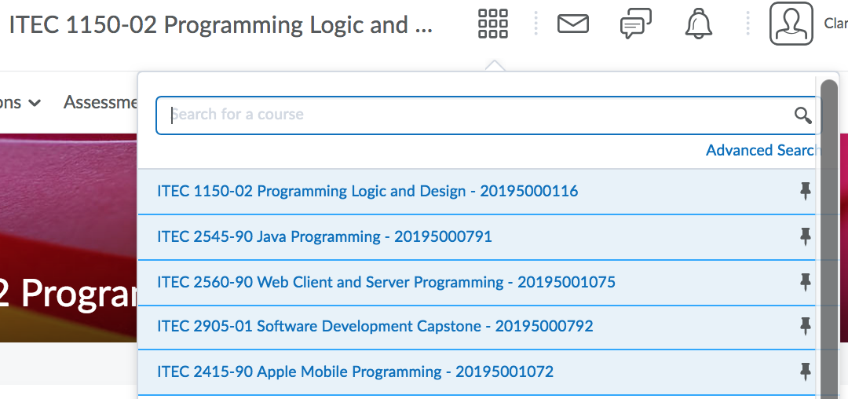
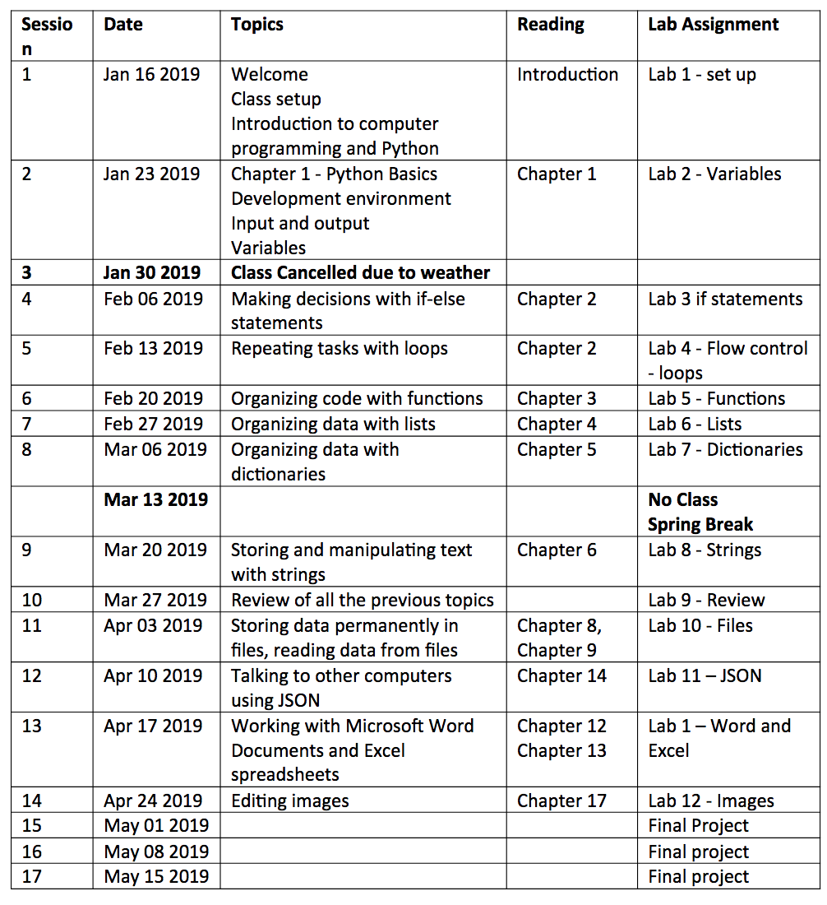
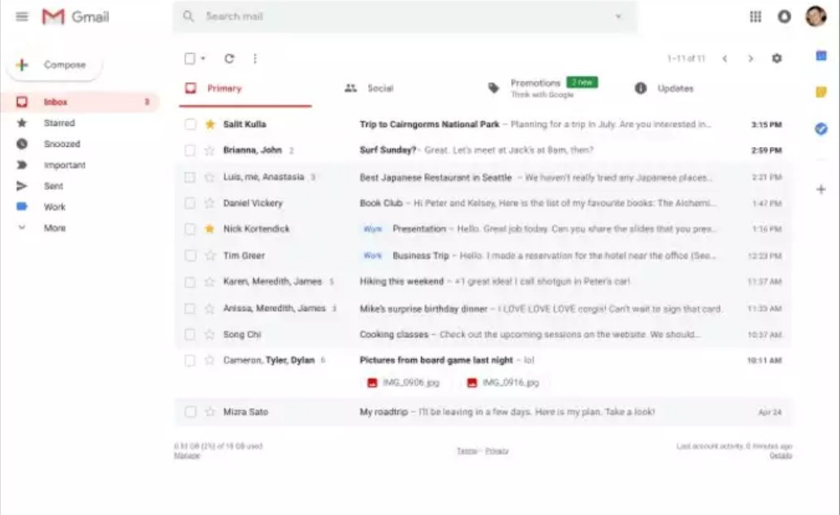
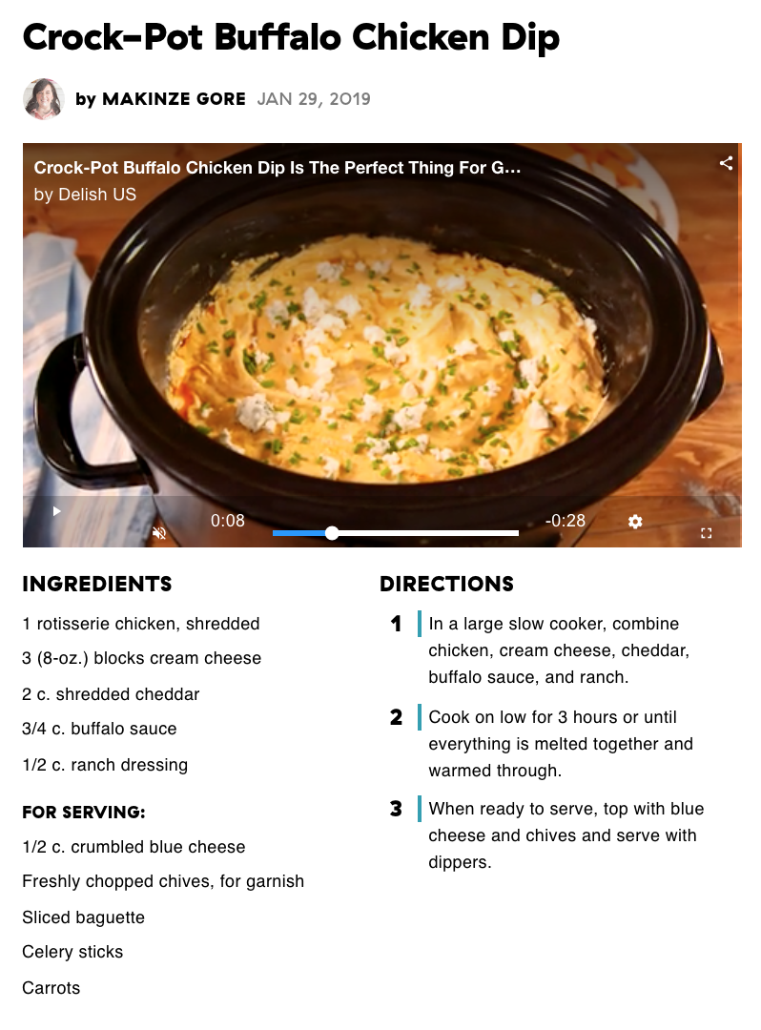
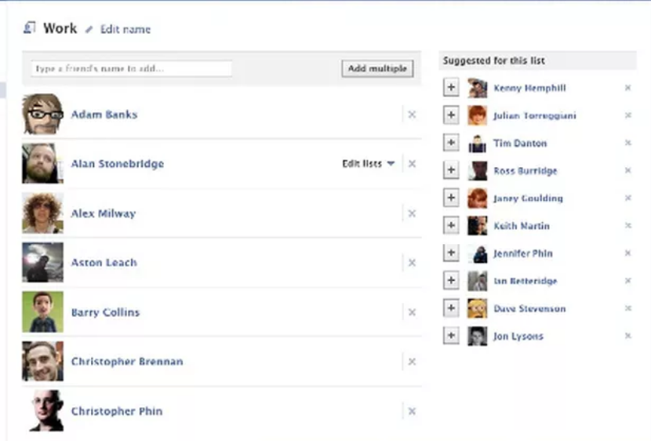

Lists are everywhere
List of classes in D2L
Friend list in social media apps
List of emails

Slide 3
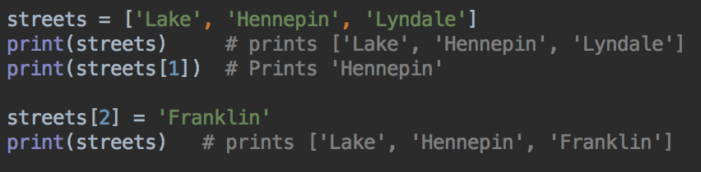
Lists
A group of items, usually of the same type, stored together
To define a list in Python, give it a name
Use square brackets [ ] to define the list
Separate the list items with commas
You can either refer to the whole list by its name
Or, you can refer to any of the list items by their position number - the list index

Slide 4
Lists
streets is the list name - a list of three Strings
In programming, we count from 0
streets[0] is 'Lake'
streets[1] is 'Hennepin'
streets[2] is 'Lyndale'
element 0
element 1
element 2

Slide 5
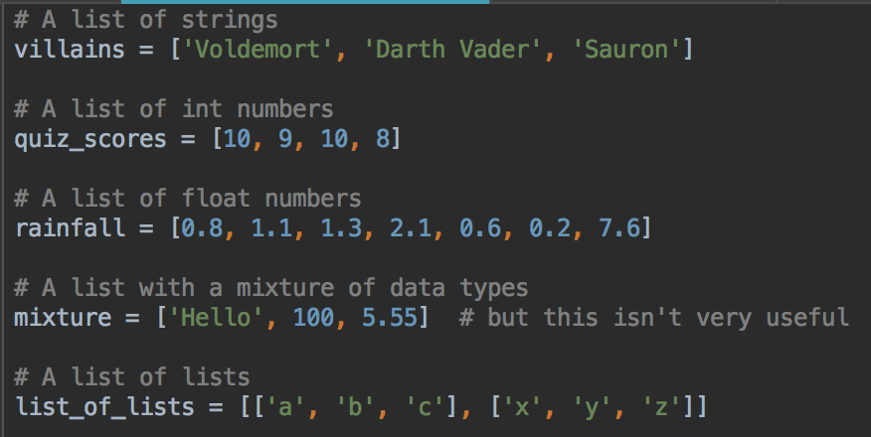
Python lists can contain different data types
Examples:
strings, integers, floats, even other lists

Slide 6
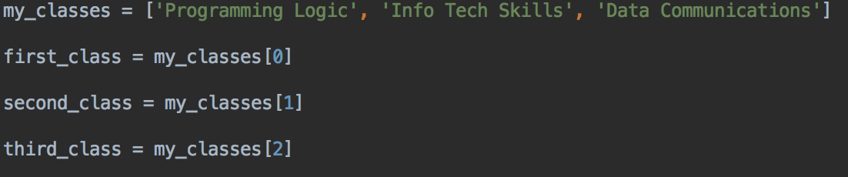
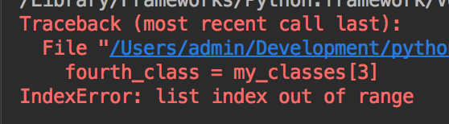
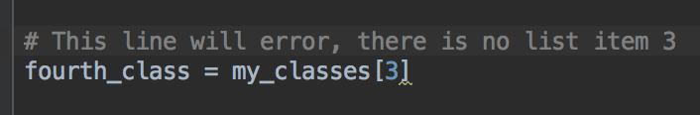
Accessing a list item - remember count from 0
What happens if this program tries to read my_classes[3] ?

Slide 7
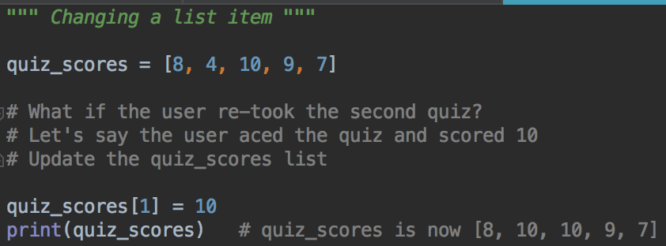
You can change list items

Slide 8
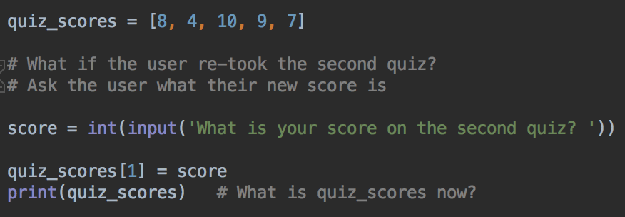
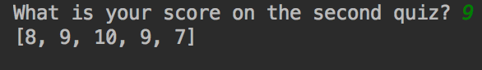
Changing list items with a variable
More common to work with variables, instead of literal data

Slide 9
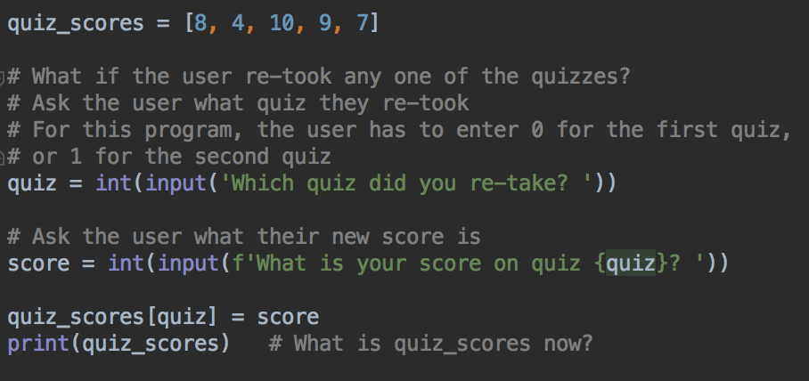
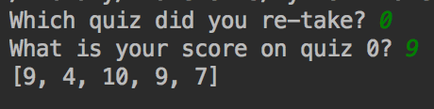
Changing list item - variable for index and data
Run and test this program
Is quiz_scores updated how you expected?

Slide 10
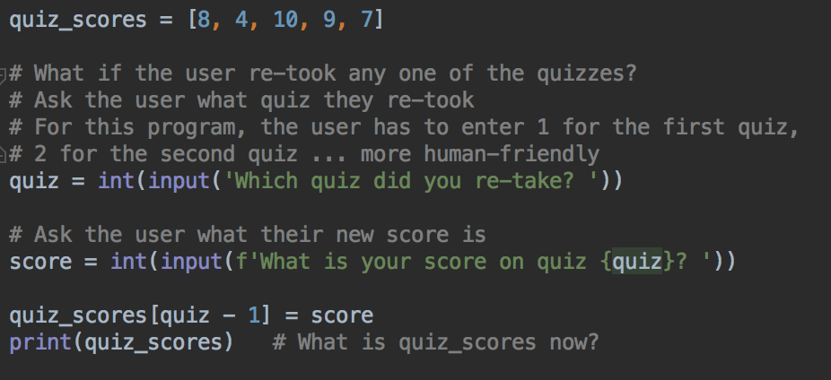
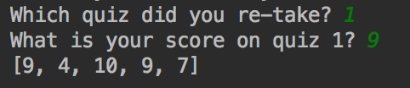
People don't usually count from 0
Modification so the user can enter 1 for the first quiz, 2 for the second quiz

Slide 11
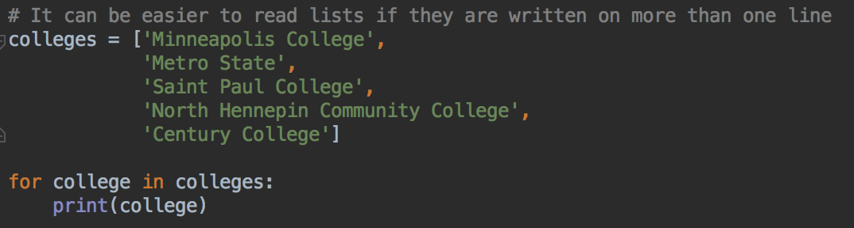
Lists & Loops
Lists and loops work well together
It's very common to process every item in a list in the same way
For example, to call a function on each list item
Or add each list item to a running total

Slide 12
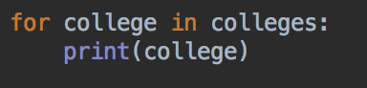
Lists and loops
This says "Repeat the loop for each item in the list in turn. Each time the loop repeats, call the list item 'college' and execute the loop body for this list item"
So the first time the loop repeats, college = 'Minneapolis College'
The second time the loop repeats, college = 'Metro State'

Slide 13
Your turn
Write the streets list
Print the first street (index 0)
Print the last street (index 2 - not 3!)
Change ‘Hennepin’ to ‘Portland’
Use a loop to print all the streets

Slide 14
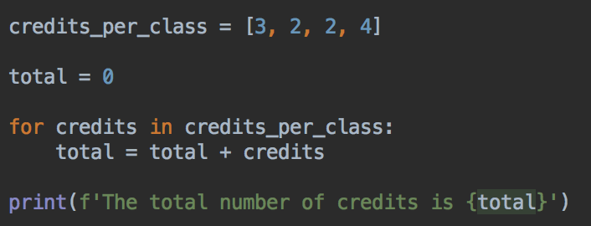
Loops
What's the total number of credits for all the classes?

Slide 15
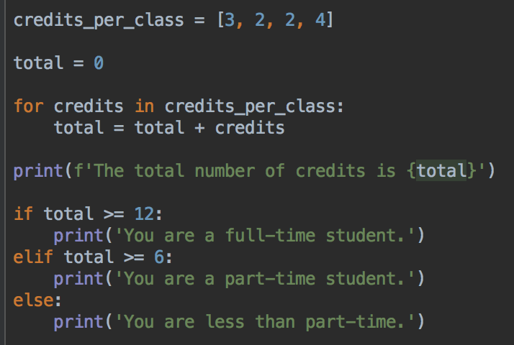
We can figure out if this is a full-time or part-time student

Slide 16
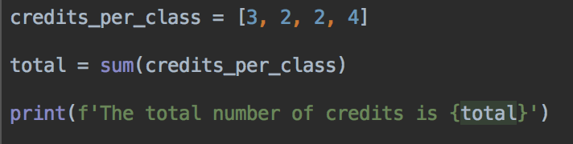
Python's built-in sum() function
Adding up lists of numbers is very common
So Python provides a sum() function

Slide 17
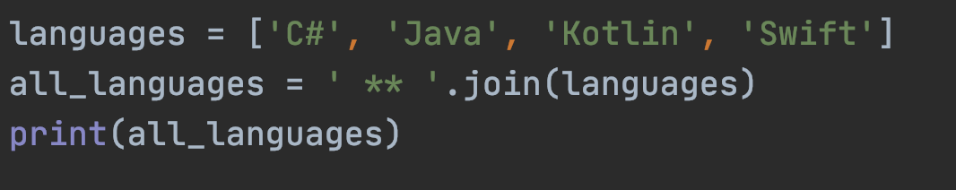
Python's built-in sum() function
sum() doesn't work with strings, but you can use the join function
Join all the strings in a list, insert another string between each one
output_string = string.join(list)
# replace string with a string and list with your list
We'll see join again when we look at strings
The string ' ** ' is used to join
the strings in the list together

Slide 18
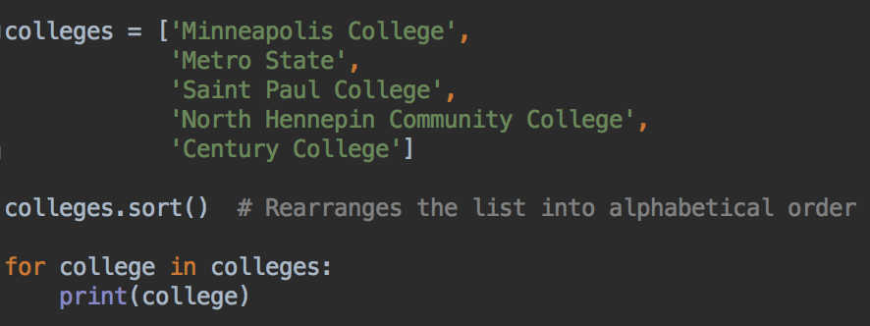
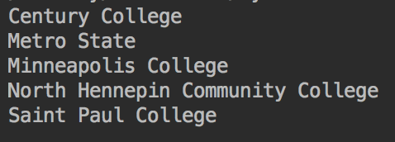
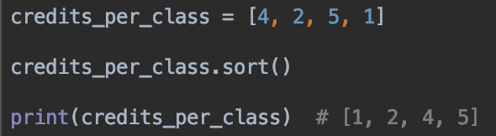
More useful built-in list functions: sort()
A list of numbers would be sorted from smallest to largest number, in numerical order

Slide 19
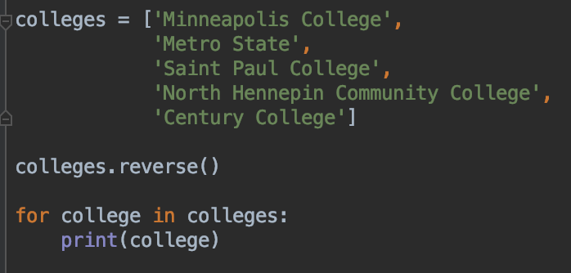
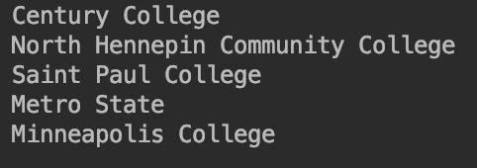
More useful built-in list functions: reverse()

Slide 20
Your turn
Start with this list (or make a list of your favorite 3 or 4 movies)
movies = ['Fargo', 'Up', 'Rocky', 'Jaws']
Can you print the movies in reverse alphabetical order?
Use a loop to print the movie titles

Slide 21
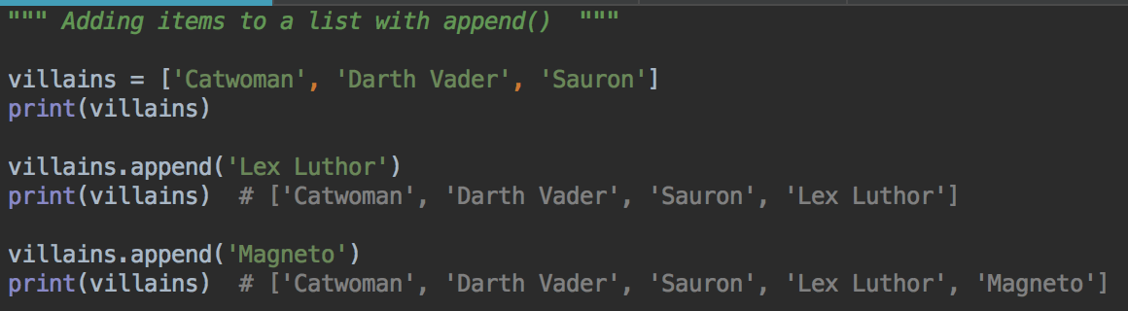
Adding things to a list with append()
Using the append method with villains list
Your turn: append your favorite movie to the movies list you just made

Slide 22
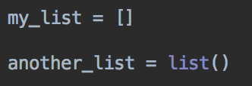
lists
You can initialize a variable to an empty list
Can be useful if you know you will be adding things to a list in your program
Two ways: either with empty [ ] or by calling list()

Slide 23
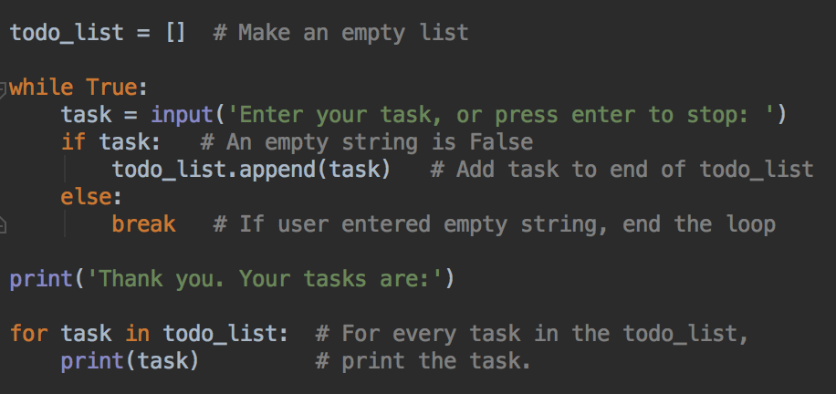
Adding Items to a list - task list program
Type this in, run and test

Slide 24
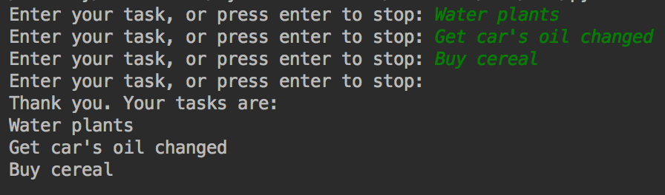
Example Output
An empty string is considered to be False, so can use that to stop the loop if the user does not type anything before pressing enter

Slide 25
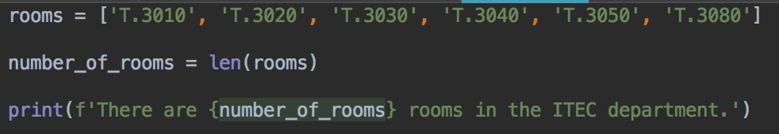
How many things in the list? len()
len() returns the number of elements in a list
Your turn: use len() to print the number of movies in your movies list

Slide 26
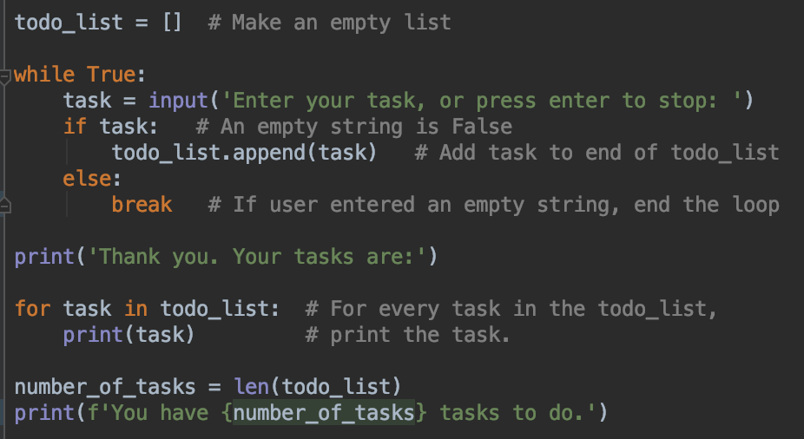
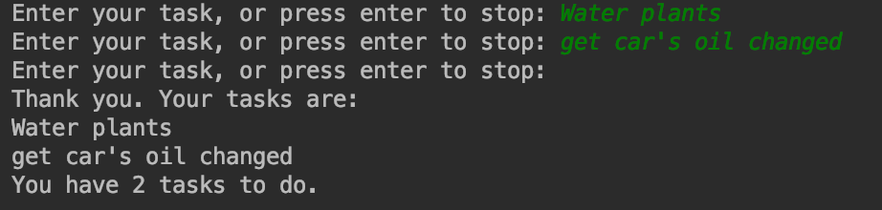
Modify the task list program to print the number of tasks
Using the len function - the length of the list represents the number of tasks

Slide 27
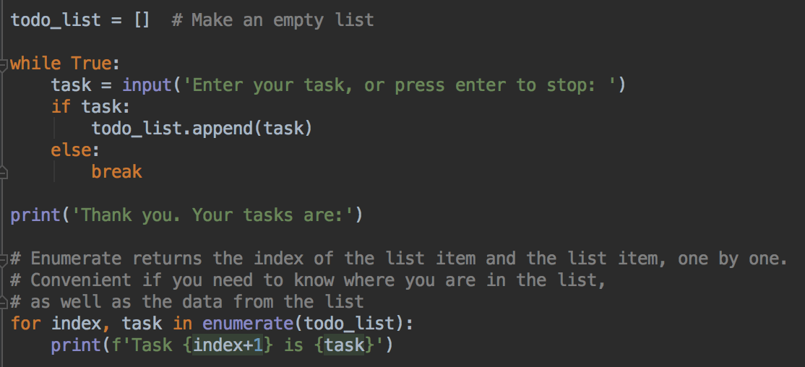
enumerate() - counting index and item when looping
Modify the loop to use enumerate()
Run and test. What does this program print?

Slide 28
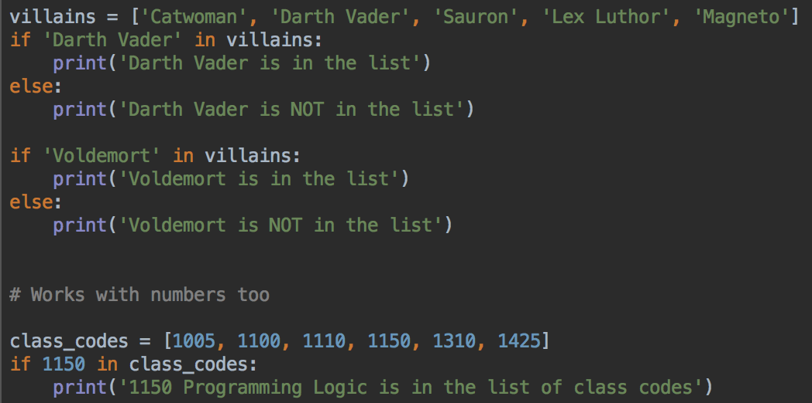
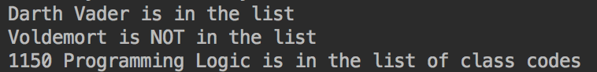
in operator for testing if an item is in a list
in is case sensitive, it checks for an exact match.
So 'darth vader' is not in the list

Slide 29
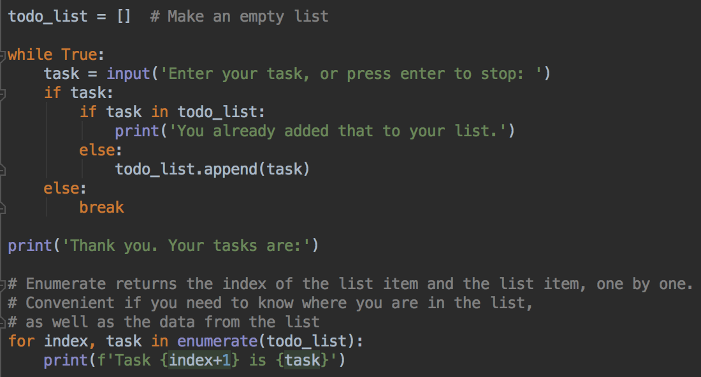
So, can avoid duplicates in the to do list
Modify your program, run and test

Slide 30
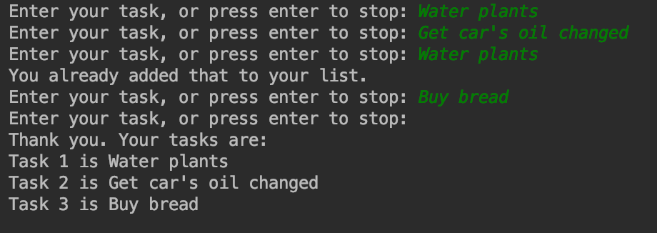
Output
Duplicates are not added
Extra question - how can you make this check case insensitive?

Slide 31
Removing things from a list
Two ways:
Use pop() if you know where in the list you want to remove the item from – what position?
Use remove() if you know what you want to remove

Slide 32
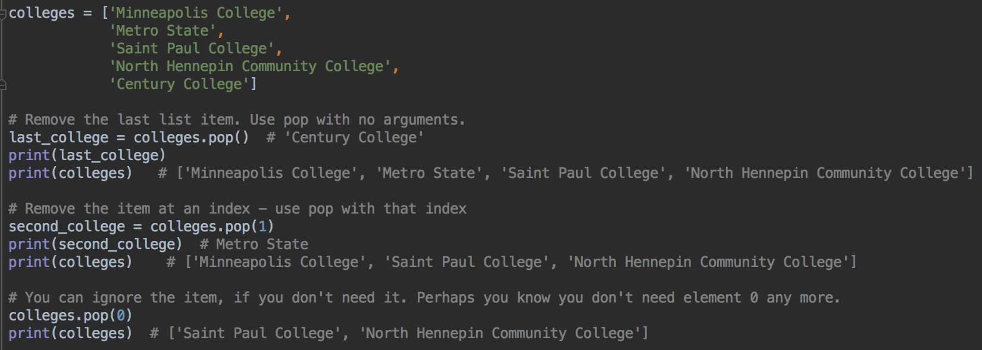
pop() - remove by index (position in list)
pop() can be called with an argument to remove the item at that index
Or it can be called with no argument, and it removes the last list item
What happens if you try to remove an index that doesn't exist?

Slide 33
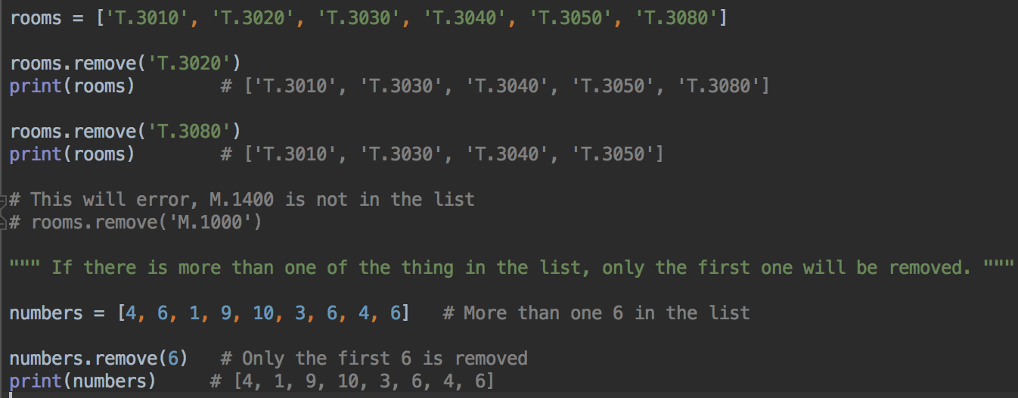
remove() - removing an item from a list
It's an error to try to remove an object that is not in the list

Slide 34
Remove vs. Pop
pop is good to remove the last item in a list, or if you know the index of the item that you want to get rid of
pop returns the list item it removed
remove is good if you know exactly how the item is spelled, or you know the exact value
remove gets rid of the first matching value
remove doesn't return anything
pop and remove both fail if the item you try to remove is not there.

Slide 35
Your turn
Use pop() to remove the last movie from your movie list
Print the list to verify it was removed
Use remove() to remove 'Jaws' from your movie list (or a movie of your choice, if you have different movies in your list
Print the list to verify it was removed

Slide 36
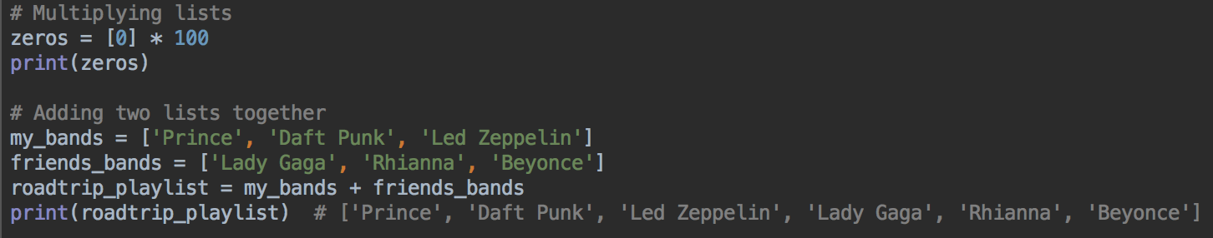
Using * and + with lists
Want a list of 100 zeros?
Want to add all the items in one list to all the items in another list?

Slide 37
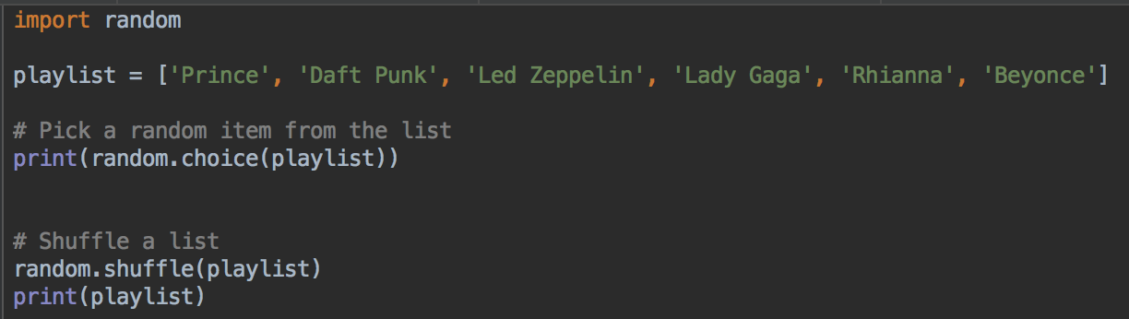
Random items
Using random methods with lists

Slide 38
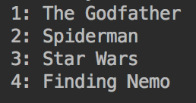
Your turn
Using your list of your favorite 4 (or 3 or 5 or 10) movies,
Use shuffle to arrange the list in a random order
Use enumerate and a loop to print a numbered list, for example:

Slide 39
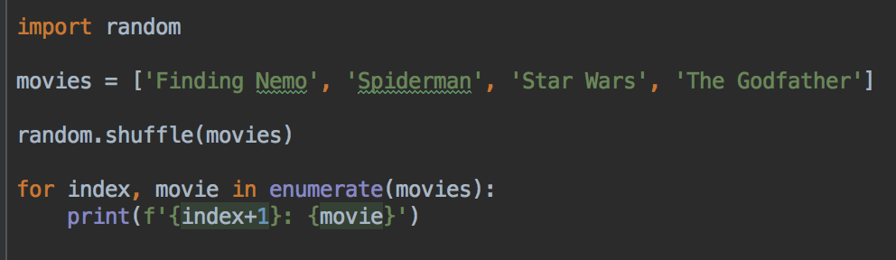
Random movie playlist
Example solution

Slide 40
Lists - summary
Lists are very useful
Lists are one of the most common data structures in Python
Now you know how to
to create empty lists, and list with data in
add data
remove data
sum all the numbers in a list
sort, shuffle and reverse the items
check if something is in a list
use them in a loop for calculations and printing
a plain loop, and with enumerate

